Slide 1

Exploratory Data Analysis
<G2M INSIGHT FOR CAB INVESTMENT>
<10/14/2023>

Slide 2

Agenda
Executive Summary
Problem Statement
Approach
EDA
EDA Summary
Recommendations

Slide 3

Executive Summary
Objective: Guide XYZ's investment in the U.S. cab industry by analyzing Pink Cab and Yellow Cab's performance from 2016-2018.
Key Metrics: Focus on customer demographics, payment trends, and city-wise distribution.
Key Findings:
Dominant Player: Yellow Cab has a larger customer base.
Preferred Payment: Card payments dominate for both, with Yellow Cab leading.
City Preferences: Distinct city-wise preferences hint at regional strategies or brand loyalties.
Goal: Equip XYZ with insights to make an informed investment decision.

Slide 4
Problem Statement
The U.S. cab industry is experiencing rapid growth with multiple emerging players.
XYZ, a private U.S. firm, is looking to invest in this sector.
A need to analyze two major cab service providers: Pink Cab and Yellow Cab.
Datasets available span from 2016 to 2018, presenting a challenge in data analysis.
Key areas of focus:
Understanding customer behaviors.
Analyzing payment trends.
Evaluating city-wise distributions.
Ultimate goal: Determine the most promising investment opportunity between the two cab companies.

Slide 5

Approach:
Data Collection:
Acquired datasets spanning 2016-2018 for Pink Cab and Yellow Cab.
Preprocessing:
Merged datasets, handled anomalies, and derived new features.
Visualization:
Used diverse techniques for clear data representation.
Comparative Analysis:
Evaluated key metrics for both cab companies across cities and time.
Insights & Recommendations:
Offered actionable insights for investment opportunities.

Slide 6
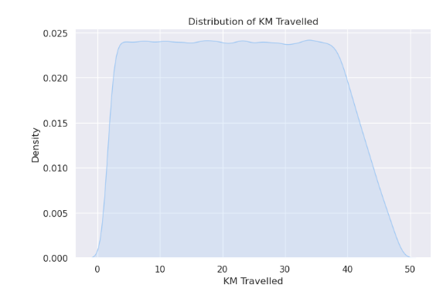
Average Distance Traveled by Customers
Both Yellow Cab and Pink Cab customers exhibit similar travel distances on average.
This similarity suggests that both companies cater to a similar clientele with comparable travel needs.
The consistency in distance might indicate standard city commutes or popular travel routes.
Understanding these travel patterns can help in optimizing cab availability and positioning.

Slide 7

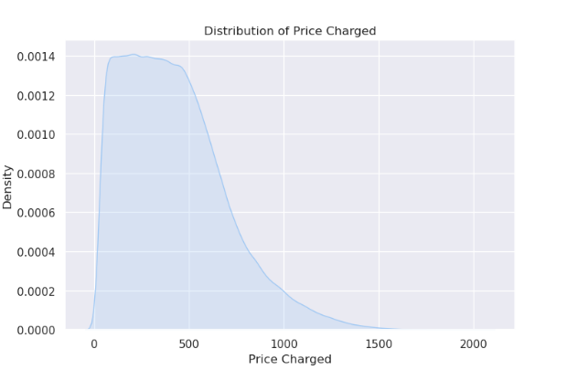
Pricing Distribution Across Cab Companies
Yellow Cab exhibits a broader pricing range compared to Pink Cab.
This might indicate diverse service tiers, special pricing events, or a wider city coverage.
Pink Cab's narrower pricing suggests a more standardized or focused service offering.
Analyzing the factors behind this pricing disparity can guide future pricing strategies and promotions.

Slide 8
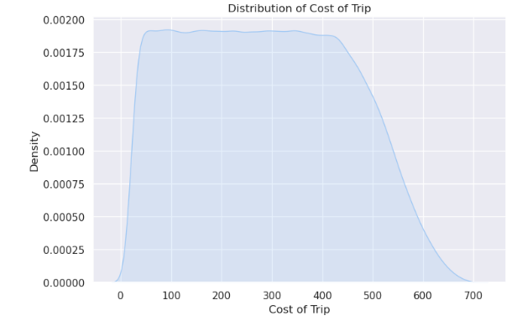
Cost Structure of Cab Rides
Both companies have comparable cost structures, indicating similar operational expenses.
Understanding these costs can help in identifying areas for efficiency improvements or cost-cutting.
A closer look at the cost components can provide insights into fuel expenses, maintenance, or driver incentives.
Cost optimization can lead to better profitability and competitive pricing.

Slide 9
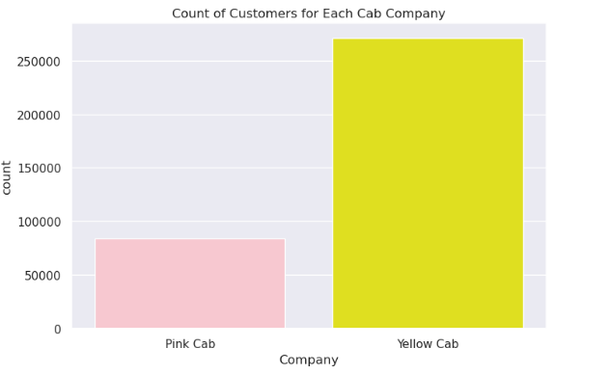
Popularity Metrics: Yellow Cab vs. Pink Cab
Yellow Cab's higher popularity score suggests a stronger brand presence and customer preference.
Factors contributing to this popularity could be effective marketing campaigns, customer service quality, or broader service availability.
Pink Cab, while trailing, has a significant score, indicating a loyal customer base and potential areas for brand enhancement.
Leveraging this popularity metric can guide future marketing strategies and customer engagement initiatives.

Slide 10
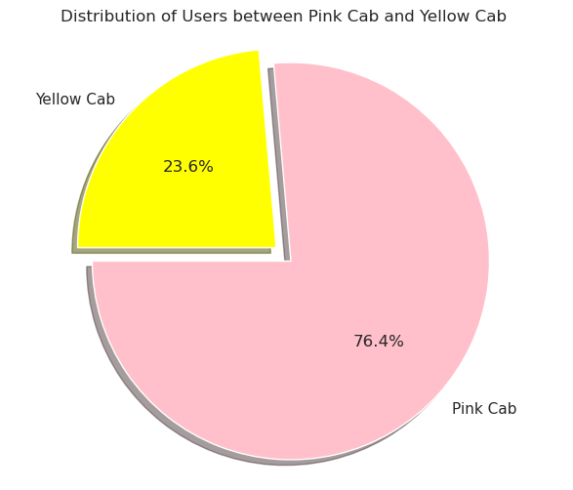
Market Share Distribution
Dominant Player: Yellow Cab holds a significant majority in the market, indicating a strong brand presence and customer trust.
Competitive Presence: Despite Yellow Cab's dominance, Pink Cab has carved out a notable market share, suggesting they offer unique value propositions or cater to specific customer segments.
Strategic Implications: The current market dynamics offer Pink Cab opportunities to identify and target areas where they can expand, while Yellow Cab should focus on retaining their market leadership.

Slide 11
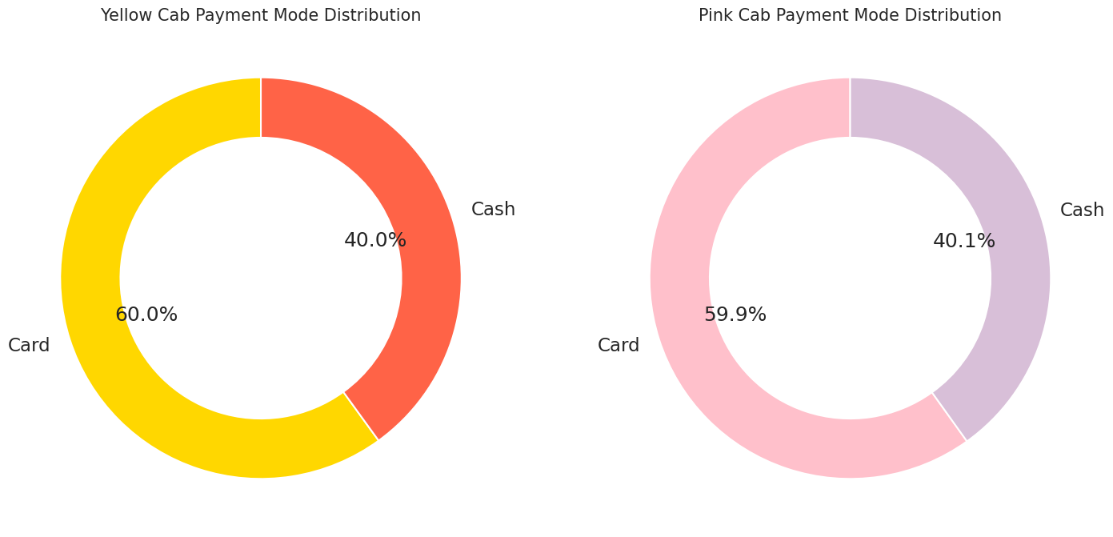
Payment Mode Distribution
Digital Dominance: A significant majority of customers from both companies prefer card payments, aligning with global trends towards digital transactions.
Diverse Preferences: Pink Cab sees a higher proportion of cash payments compared to Yellow Cab, indicating a diverse customer base with varied payment preferences.
Operational Insights: Yellow Cab's higher card payment ratio may suggest streamlined digital payment processes or incentives for cashless transactions.

Slide 12
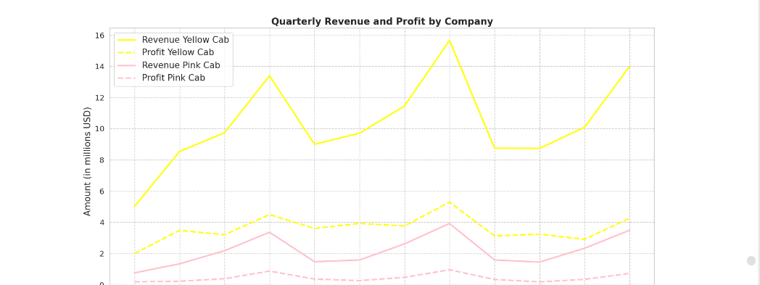
Quarterly Revenue and Profit Analysis
Consistent Leadership: Yellow Cab consistently outshines Pink Cab in both revenue and profit metrics across all quarters.
Seasonal Peaks: Both companies exhibit revenue peaks in Q2 and Q4, suggesting potential seasonal promotions or external factors influencing customer behavior.
Strategic Planning: These insights can guide both companies in planning their quarterly strategies, promotions, and operational focuses.

Slide 13
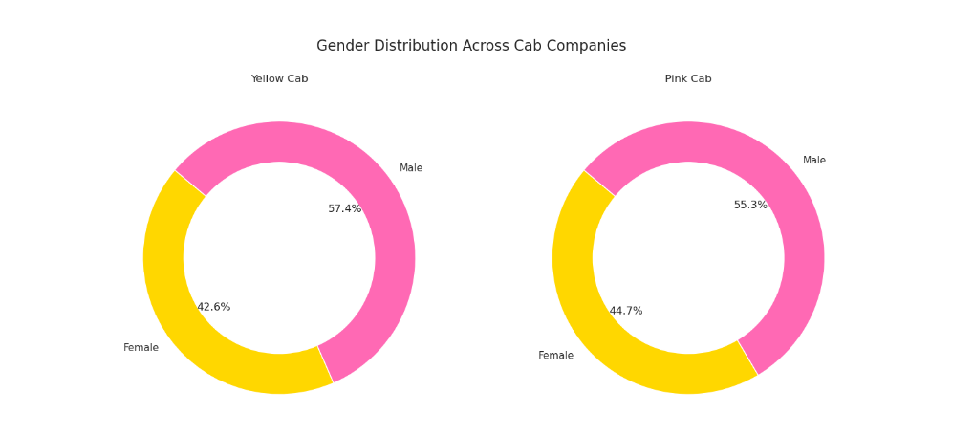
Demographic Dive: Gender Insights
Balanced Demographics: Both cab companies cater to a fairly balanced gender distribution, with a slight male dominance for Yellow Cab.
Market Opportunities: The gender distribution offers insights into potential targeted marketing campaigns or service offerings tailored to specific gender preferences.
Operational Implications: Understanding gender preferences can also guide operational decisions, such as safety features or partnerships.

Slide 14
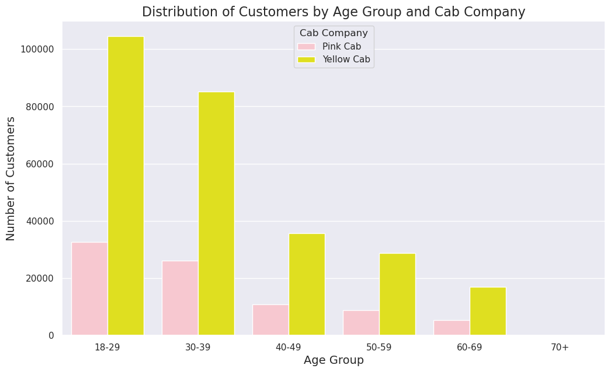
Age Demographics: Targeting the Right Audience
Youth Appeal: A significant portion of customers for both cab companies falls within the 20-40 age bracket, indicating the services' popularity among young professionals and millennials.
Strategic Marketing: The age distribution insights can guide targeted marketing campaigns, loyalty programs, or partnerships with brands popular among specific age groups.
Service Tailoring: Understanding age preferences can also help in tailoring the service offerings, such as tech integrations, ride comfort, or entertainment options.

Slide 15
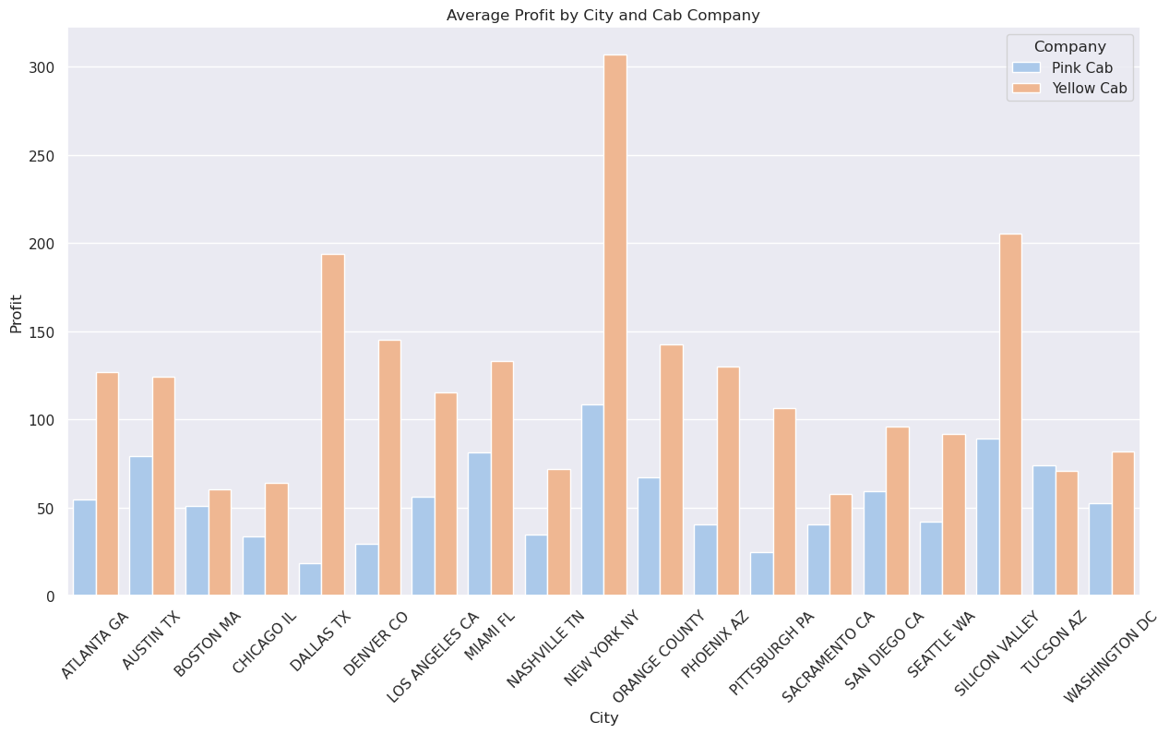
Profit Distribution by City
City Variations: There are significant variations in profit across different cities for both cab companies.
Regional Dominance: Some cities emerge as strongholds for one company over the other, suggesting regional preferences or operational efficiencies.
Expansion Opportunities: The city-wise profit distribution offers insights into potential areas for expansion, consolidation, or strategic partnerships.

Slide 16
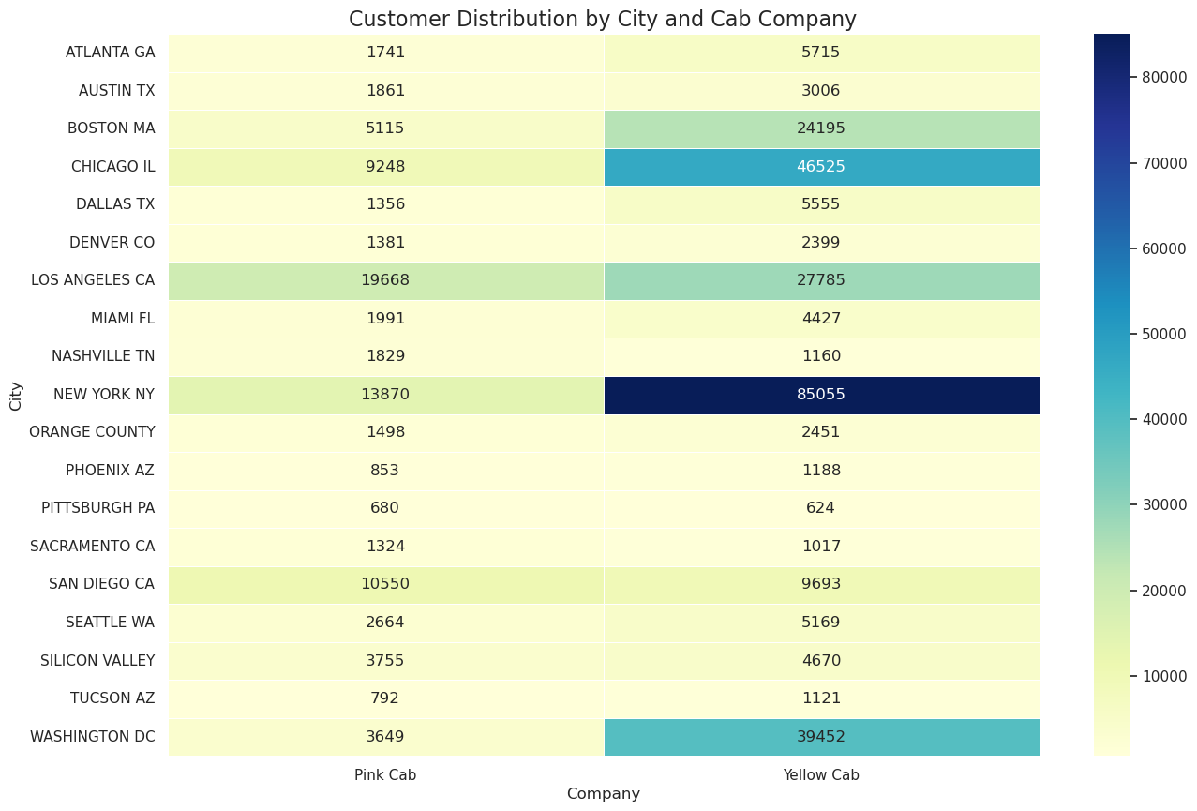
Customer Distribution by City
Diverse Concentrations: The customer distribution varies across cities, with some cities showing a dominant presence of one cab company.
Strategic Implications: Such insights can guide city-specific marketing campaigns, partnerships, or service offerings to cater to the local audience.
Operational Decisions: Understanding where the majority of customers are located can also help in optimizing operations, fleet management, and driver training.

Slide 17
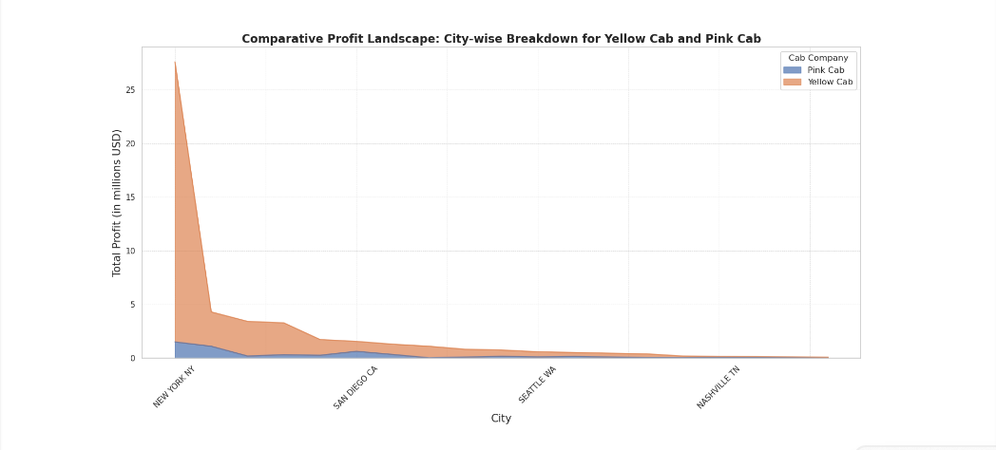
Comparative Profit Insights by City
City Leaders: Yellow Cab leads in profit in most cities, but Pink Cab shows competitive profit margins in specific regions.
Operational Excellence: The comparative profit landscape offers insights into city-specific operational efficiencies, pricing strategies, and customer preferences.
Strategic Planning: Such data can guide both companies in their city-specific strategies, promotions, and partnerships.

Slide 18

EDA Summary Slide:
Content:
Data Integrity: Comprehensive data cleaning ensured reliable analysis.
Metrics Overview: Evaluated customer demographics, financial metrics, and more.
Temporal Patterns: Seasonal trends identified in quarterly revenue and profit.
City Insights: Regional preferences and operational strengths were evident.
Payment Trends: Card payments dominated, indicating a shift towards digital transactions.
Market Dynamics: Yellow Cab led in most areas, but Pink Cab had its strengths.
Demographics: Gender and age data offered insights into the core customer base.
Closing Note: Our EDA offers a snapshot of the cab industry, setting the stage for strategic recommendations

Slide 19

Recommendations
Content:
Expand Payment Modes: Consider adding digital wallets alongside card payments.
Prioritize High-Profit Cities: Focus on New York and Los Angeles for better returns.
Loyalty Programs: Introduce incentives for frequent Yellow Cab users.
Marketing for Pink Cab: Target cities like San Diego and Nashville with tailored campaigns.
Optimize Operations: Reduce operational costs in cities like Washington DC.
Tech Upgrades: Enhance user experience with modern tech features.
Local Collaborations: Partner with businesses in cities like Boston for promotions.
Closing Note: Implementing these strategies can drive growth and profitability for both cab companies.

Slide 20

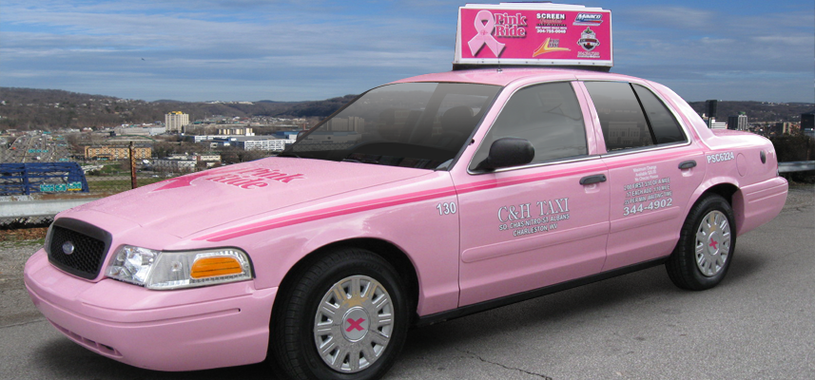
Thank You

